Slide 1
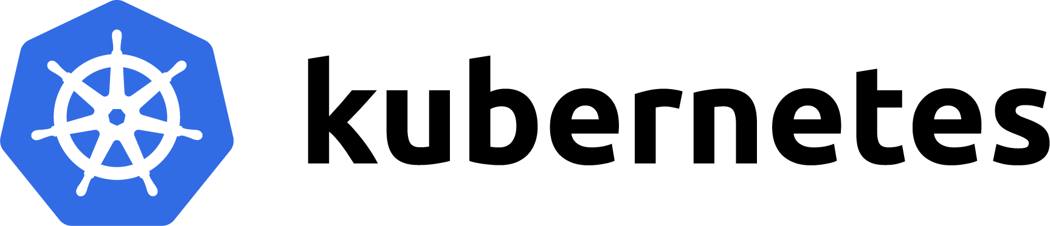
Overview to Kubernetes(K8s)

Slide 2
Introduction to Kubernetes
Kubernetes architecture
Main K8s Components
How to Spin Up a Kubernetes Cluster
Minikube and Kubectl – Installing Kube Control (kubectl)
Main Kubectl Commands – K8s CLI
Working of Kubernetes
Deployments in Kubernetes
K8s Services
K8s YAML Configuration File
Hands - On Demo
K8s Namespaces – Organizing components
K8s Ingress
Helm Package Manager
Volumes- Persisting Data in K8s
K8s Stateful Set – Deploying Stateful Apps
K8s Secrets
K8s Network Policy
K8s Autoscaling
Kubernetes Monitoring Setup
Kubernetes Application
What is Kubernetes?

Slide 3
Prerequisites
Some of the prerequisites on your path to learning Kubernetes will be a decent knowledge of how Docker and containers work. These systems are different from Virtual Machines and Virtual Private Servers, which are widely used in the industry.
Other concepts such as Network Configuration and Linux will also come handy in grasping Kubernetes quickly.

Slide 4
Quick Introduction to Kubernetes
Kubernetes in an open-source container management tool hosted by Cloud Native Computing Foundation (CNCF). This is also known as the enhanced version of Borg which was developed at Google to manage both long running processes and batch jobs, which was earlier handled by separate systems.
Kubernetes comes with a capability of automating deployment, scaling of application, and operations of application containers across clusters. It can create container centric infrastructure.
Kubernetes is the Linux kernel which is used for distributed systems. It helps you to be abstract the underlying hardware of the nodes(servers) and offers a consistent interface for applications that consume the shared pool of resources..

Slide 5
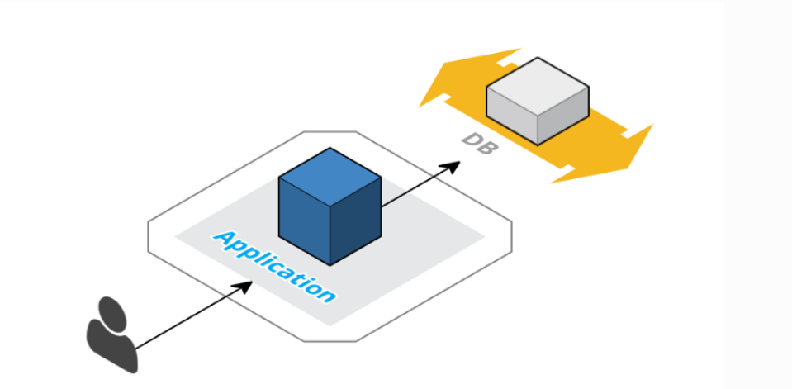
How Kubernetes Solves the Problem?
Container Orchestration & Kubernetes
Containers are virtual machines. They are lightweight, scalable, and isolated. The containers are linked together for setting security policies, limiting resource utilization, etc. If your application infrastructure is like the image shared below, then container orchestration is necessary.
It might be Nginx/Apache + PHP/Python/Ruby/Node.js app running on a few containers, communicating with the replicated database. Container orchestration will help you manage everything by yourself.

Slide 6
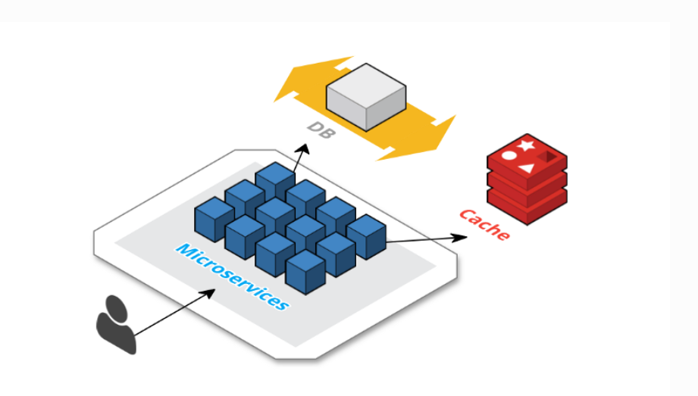
How Kubernetes Solves the Problem?
Consider that your application keeps on growing. For example, you keep on adding more features/functionalities and at some point, in time, you realize that it has suddenly become a huge monolith.
Now, it is impossible to manage the vast application because it eats up your CPU and RAM. So, you finally decide to split the application into smaller chunks. Each one of them with a specific task. Now, your infrastructure looks like this:

Slide 7
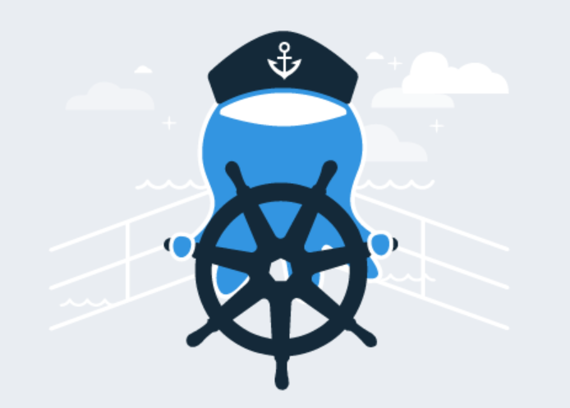
How Kubernetes Solves the Problem?
So, you need a caching layer with some queue system for a better asynchronous performance. Now, there are challenges like service discovery, load balancing, health checks, storage management, auto-scaling, etc.
Under all such hectic circumstances, who will come to your help? Yes, container orchestration will be your savior! The reason is that container orchestration is extremely powerful and solves most of the challenges.
So, what are the options?
The main players are Kubernetes, AWS ECS, and Docker Swarm. Out of all these, Kubernetes is the most popular! Kubernetes offers the largest community. Kubernetes solves all the major issues described. It is portable and runs on most of the cloud providers, bare-metal, hybrids, and the combination of all these. Further, it is also configurable and modular. It provides features like auto-placement, auto-restart, auto-replication, and auto-healing of containers.

Slide 8
The need for a container orchestration tool
Trend from Monolith to Microservices Architecture
Increased usage of containers
Demand for a proper way of managing those hundreds of containers
What features do Orchestration tool offer?
High Availability or no downtime
Scalability or high performance
Disaster Recovery – backup or restore

Slide 9
What is Kubernetes?
Kubernetes is an open-source container orchestration platform developed by Google for managing microservices or containerized applications across a distributed cluster of nodes.
It was released on July 21,2015.
Kubernetes is highly resilient and supports zero downtime, rollback, scaling, and self-healing of containers. The main objective of Kubernetes is to hide the complexity of managing a fleet of containers.
It can run on bare metal machines or on public or private cloud platforms such as AWS, Azure and OpenStack.
Kubernetes architecture follows a client-server architecture.

Slide 10
What can Kubernetes do for you?
With modern web services, users expect applications to be available 24/7, and developers expect to deploy new versions of those applications several times a day.
Containerization helps package software to serve these goals, enabling applications to be released and updated without downtime. Kubernetes helps you make sure those containerized applications run where and when you want and helps them find the resources and tools they need to work.
Kubernetes is a production-ready, open-source platform designed with Google's accumulated experience in container orchestration, combined with best-of-breed ideas from the community.

Slide 11
Why use Kubernetes?
Companies out there maybe using Docker or Rocket or maybe simply Linux containers for containerizing their applications. But, whatever it is, they use it on a massive scale. They don’t stop at using 1 or 2 containers in Prod. But rather, 10’s or 100’s of containers for load balancing the traffic and ensuring high availability.
Keep in mind that, as the traffic increases, they even have to scale up the number of containers to service the ‘n’ no of requests that come in every second. And, they have to also scale down the containers when the demand is less.
Kubernetes helps to control the resource allocation and traffic management for cloud applications and microservices.
It also helps to simplify various aspects of service-oriented infrastructures.
Kubernetes allows to assure where and when containerized applications run and helps to find resources and tools want to work with.

Slide 12
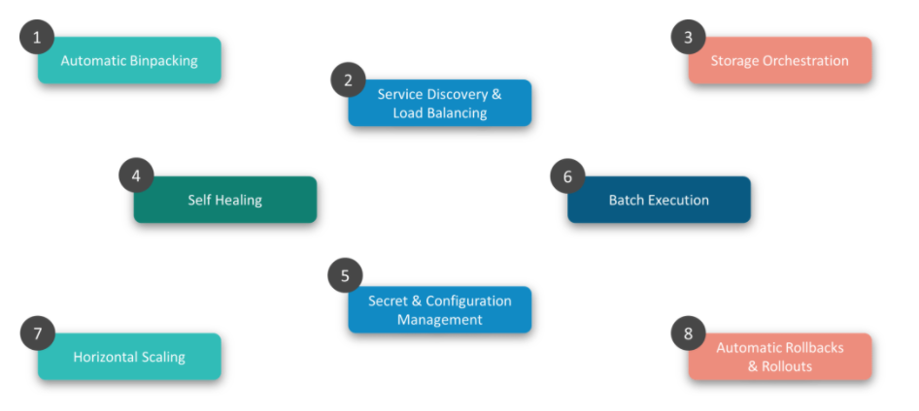
Kubernetes Features

Slide 13

Kubernetes Features
Automatic Binpacking
Kubernetes automatically packages your application and schedules the containers based on their requirements and available resources while not sacrificing availability. To ensure complete utilization and save unused resources, Kubernetes balances between critical and best-effort workloads.

Slide 14
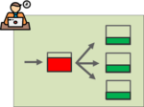
Kubernetes Features
2. Service Discovery & Load balancing
With Kubernetes, there is no need to worry about networking and communication because Kubernetes will automatically assign IP addresses to containers and a single DNS name for a set of containers, that can load-balance traffic inside the cluster.

Slide 15
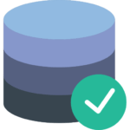
Kubernetes Features
3. Storage Orchestration
With Kubernetes, you can mount the storage system of your choice. You can either opt for local storage, or choose a public cloud provider such as GCP or AWS, or perhaps use a shared network storage system such as NFS, iSCSI, etc.

Slide 16

Kubernetes Features
4. Self-Healing
Kubernetes can automatically restart containers that fail during execution and kills those containers that don’t respond to user-defined health checks. But if nodes itself die, then it replaces and reschedules those failed containers on other available nodes.

Slide 17

Kubernetes Features
5. Secret & Configuration Management
Kubernetes can help you deploy and update secrets and application configuration without rebuilding your image and without exposing secrets in your stack configuration.

Slide 18
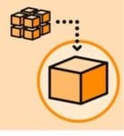
Kubernetes Features
6. Batch Execution
In addition to managing services, Kubernetes can also manage your batch and CI workloads, thus replacing containers that fail, if desired.

Slide 19
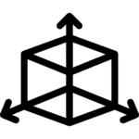
Kubernetes Features
7. Horizontal Scaling
Kubernetes needs only 1 command to scale up the containers, or to scale them down when using the CLI. Else, scaling can also be done via the Dashboard (kubernetes UI).

Slide 20

Kubernetes Features
8. Automatic Rollbacks & Rollouts
Kubernetes progressively rolls out changes and updates to your application or its configuration, by ensuring that not all instances are worked at the same instance. Even if something goes wrong, Kubernetes will rollback the change for you.

Slide 21
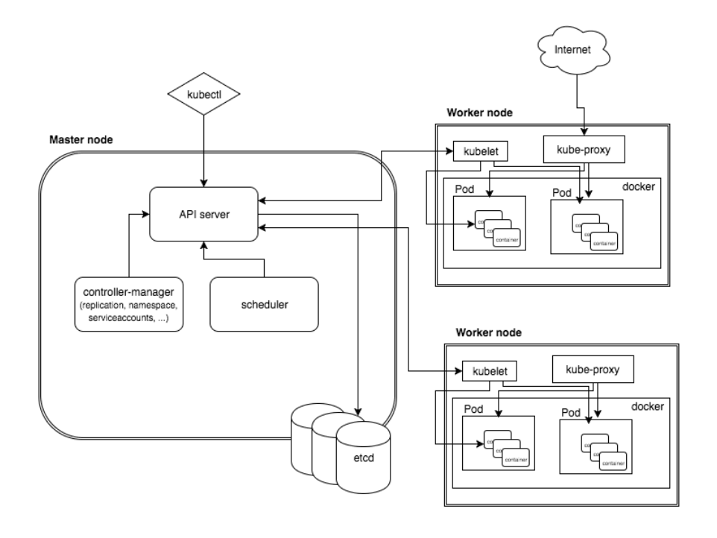
Kubernetes Architecture
A K8s setup consists of several parts, some of them optional, some mandatory for the whole system to function.
This is a high-level diagram of the architecture

Slide 22
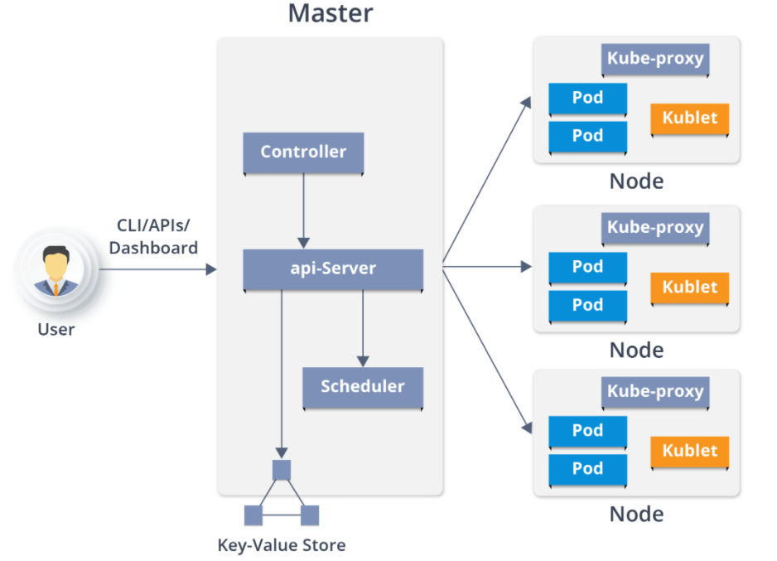
Kubernetes Architecture

Slide 23
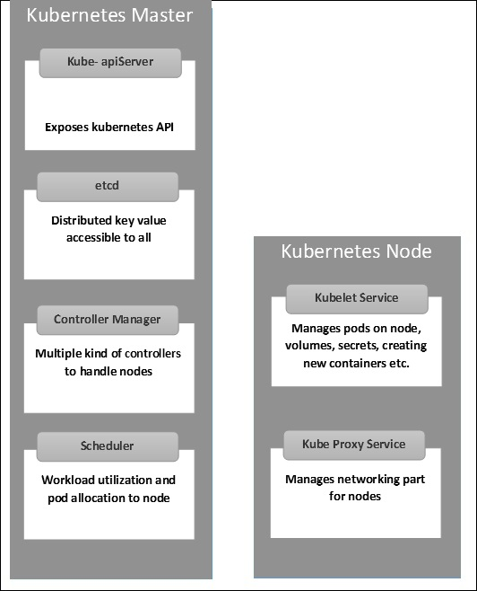

Slide 24
Kubernetes Hardware
There are different types of hardware required for Kubernetes. Understand one thing that Kubernetes itself doesn’t need hardware, but the functioning system needs all the hardware.
Nodes
What is a node in Kubernetes?
One of the smallest units of computing in Kubernetes is known as a node. It is a singular machine and resides in a cluster. Node doesn’t necessarily need to be a physical machine or a part of the hardware. It is either a physical machine or a virtual machine. For the data center, a node is a physical machine. Similarly, for Google Cloud Platform, a node is a virtual machine.

Slide 25
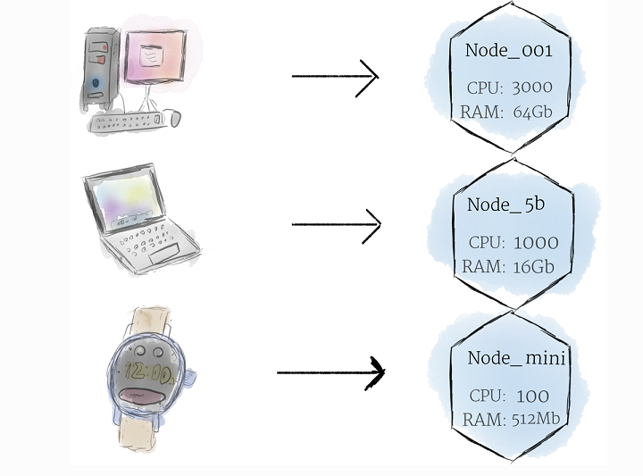
There is always a layer of abstraction for nodes in any machine. But here, there is no need to worry about the characteristics of a machine. In fact, we can simply view each machine as a set of CPU and RAM resources. These machines are in a cluster and their resources can be used as per the requirement.

Slide 26
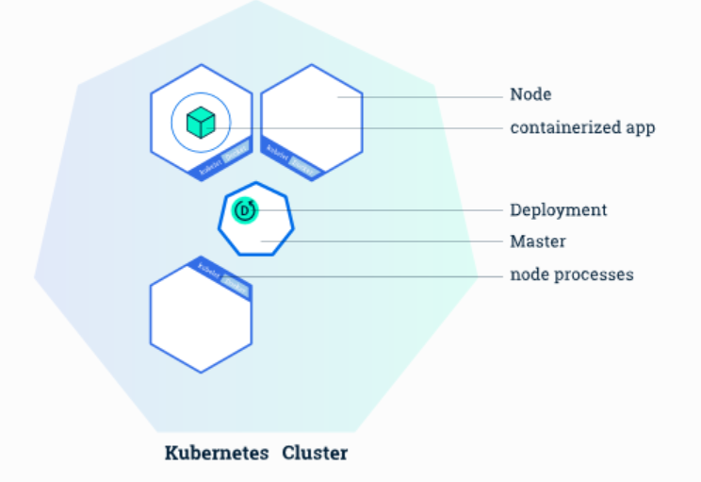
Cluster
We have already discussed nodes, right? They appear to be small and cute processing units. They do their job in their own small home. All this sounds perfect, but it isn’t the Kubernetes way yet! So there comes the cluster. We don’t need to worry about the state of individual nodes because they are a part of the cluster.
For example, if the individual nodes aren’t performing well, there should be someone to manage all this. Also, a cluster is a collection of multiple nodes. All the nodes pool together their resources and together make a powerful machine.
The cluster is intelligent. Do you know why? When the programs are deployed onto the cluster, it dynamically handles the distribution. In short, it assigns tasks to individual nodes. In between the process, if any node is added or removed, the cluster shifts the work as per the need.

Slide 27
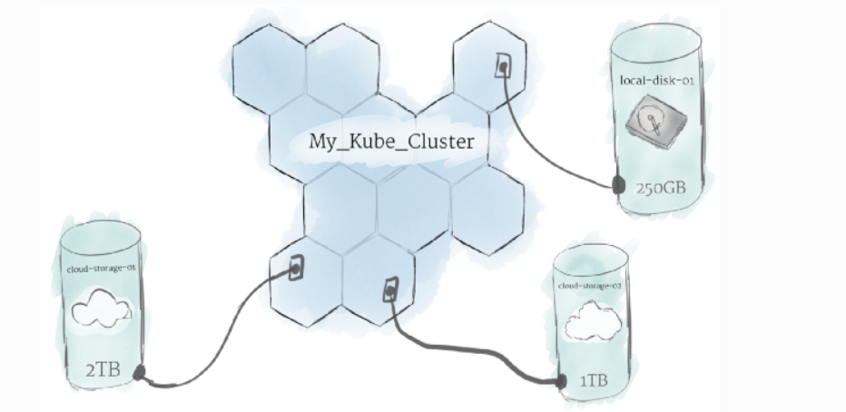
The Persistent Volumes
As mentioned, the programs run on the cluster and are powered by the nodes. But they don’t run on specific nodes. The programs run dynamically. Thus, there is a need for storing the information and it can’t be stored randomly in any file system. Why? For example, a program saves the data to a file. But later, the program is relocated to another node. Next time when the program needs the file, it won’t be at the expected place. The location address is changed. To solve this problem, the traditional local storage related to each node is considered as a temporary cache for holding programs. But any locally saved data can’t be expected to persist.

Slide 28
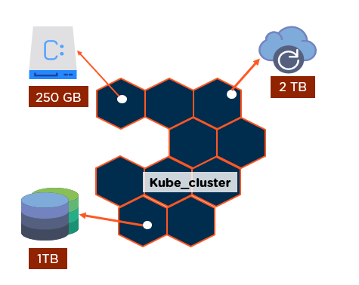
The Persistent Volumes
So, who stores data permanently? Yes, the persistent volumes store it permanently. The cluster manages the CPU and RAM resources for all the nodes. But the cluster is not responsible for storing data permanently in the persistent volume. The local drives and cloud drives can be attached to the cluster like a persistent volume. It is something like plugging an external drive to the cluster. The persistent volumes offer a file system. It can be mounted to the cluster without being associated to any specific node.
Kubernetes Persistent Volumes remain on a pod even after the pod is deleted. It’s used for the temporary storage of data.

Slide 29
Kubernetes Software
The overall concept of Kubernetes is based on software. So, this is the main part of Kubernetes.
Containers
In Kubernetes, Linux containers host the programs. These containers are globally accepted and already have pre-built images. The images can be deployed on Kubernetes. It allows you to create Linux execution environments.
The programs, as well as its dependencies, are packed in one single file and shared on the internet. So, anyone can download the container and deploy it on their infrastructure as per the requirement. Deployment is hassle-free with just a little setup. A container can be created with the help of a program. This enables the formation of effective CI and CD pipelines.
The containers are capable of handling multiple programs. But it is recommended to limit one process per container because it helps in troubleshooting. Updating the containers is easy and the deployment is easy if it is small. It is better to have many small containers, rather than a big one.

Slide 30
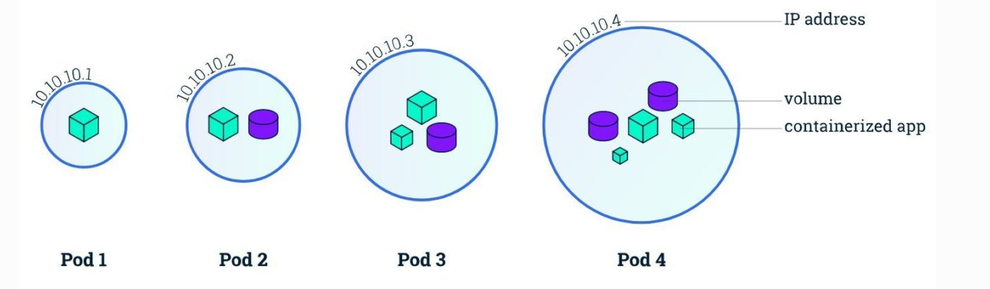
Pod
Kubernetes has some unique features and one of them is that it doesn’t run the containers directly. It rather wraps up one or more containers into a pod. The concept of a pod is that any containers within the same pod use the same resources and the same local network.
The benefit is that the containers can communicate with each other easily. They are isolated but are readily available for communication.
The pods can replicate in Kubernetes. For example, an application becomes popular, and a single pod isn’t able to sustain the load. At that moment, Kubernetes can be configured for deploying new replicas of the pod as per the requirement.
But it is not necessary that replication occurs only during heavy load. A pod can replicate during normal conditions as well. This helps in uniform load balancing and resisting failures.

Slide 31
Pod
Kubernetes has some unique features and one of them is that it doesn’t run the containers directly. It rather wraps up one or more containers into a pod. The concept of a pod is that any containers within the same pod use the same resources and the same local network.
The benefit is that the containers can communicate with each other easily. They are isolated but are readily available for communication.
The pods can replicate in Kubernetes. For example, an application becomes popular, and a single pod can’t sustain the load. At that moment, Kubernetes can be configured for deploying new replicas of the pod as per the requirement.
But it is not necessary that replication occurs only during heavy load. A pod can replicate during normal conditions as well. This helps in uniform load balancing and resisting failures.
Pods can hold multiple containers, but one should limit one or two if possible. The reason is that the pods scale up and down as a single unit. The containers within the pod must also scale together with the pods.

Slide 32
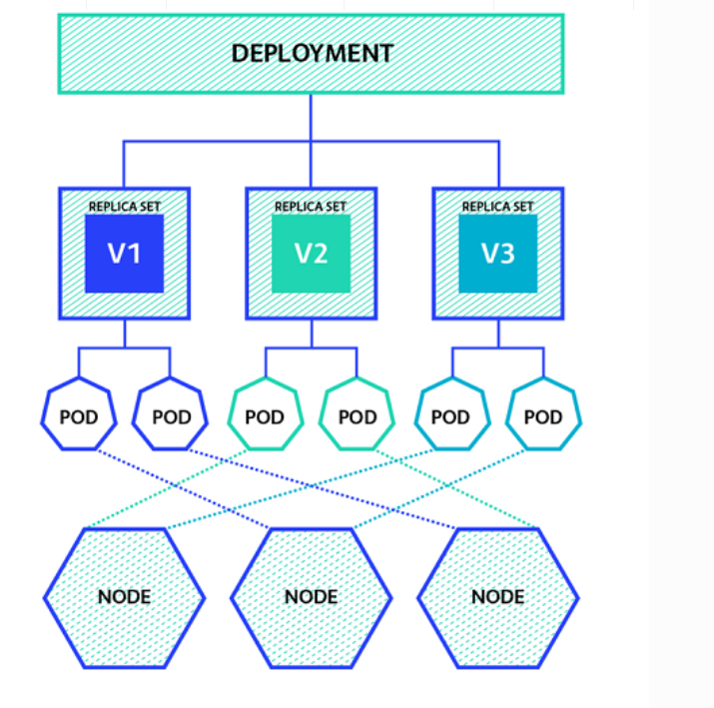
Deployment
If you notice, pods are the basic units in Kubernetes. But they aren’t launched directly on a cluster. They are managed by more than one layer of abstraction. This overall makes “deployment”. The main purpose is to declare the number of replicas running at a time.
When the deployment is added, it spins up the number of pods and monitors them. Similarly, if the pod doesn’t exist anymore, its deployment re-creates it.
The fun part is that with deployment, there is no need to deal with pods. By declaring the state of the system, everything is managed automatically.

Slide 33
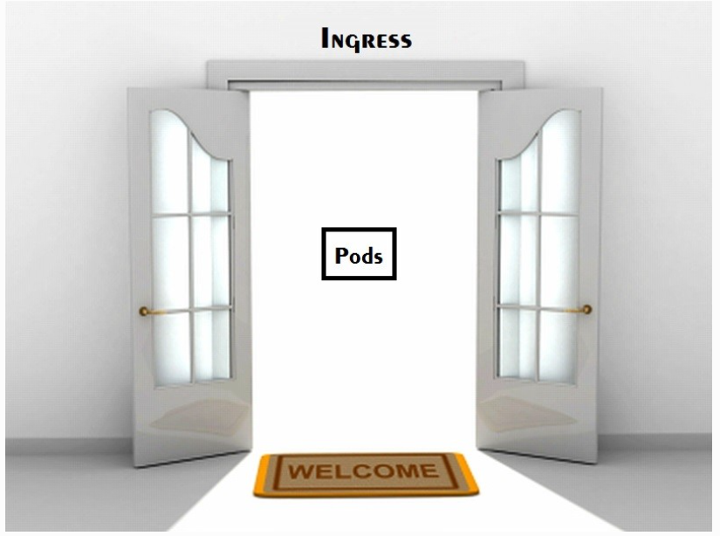
Ingress
We have discussed all the basic concepts of Kubernetes. Using them, you can create a cluster of nodes. Once the cluster is made, it is time to launch deployments of pods on the cluster. But how will you allow external traffic to your application?
As per the concept of Kubernetes, it offers isolation between pods and the outside world. To communicate with a service running within a pod, the outsider needs to open a channel. The channel is a medium of communication. It is known as “ingress”.
There are numerous ways for adding an ingress to the cluster. The most common being through an Ingress Controller or Load Balancer.

Slide 34
Advantages of Kubernetes
Easy organization of service with pods
It is developed by Google, who bring years of valuable industry experience to the table
Largest community among container orchestration tools
Offers a variety of storage options, including on-premises, SANs and public clouds
Adheres to the principals of immutable infrastructure
Kubernetes can run on-premises bare metal, OpenStack, public clouds Google, Azure, AWS, etc.
Helps you to avoid vendor lock issues as it can use any vendor-specific APIs or services except where Kubernetes provides an abstraction, e.g., load balancer and storage.
Containerization using Kubernetes allows package software to serve these goals. It will enable applications that need to be released and updated without any downtime.
Kubernetes allows you to assure those containerized applications run where and when you want and helps you to find resources and tools which you want to work.

Slide 35
Disadvantages of Kubernetes
Kubernetes dashboard not as useful as it should be.
Kubernetes is a little bit complicated and unnecessary in environments where all development is done locally.
Security is not very effective.

Slide 36
How to Spin Up a Kubernetes Cluster
Currently, several services around the globe provide different Kubernetes implementations. Among the most popular ones, you will find:
Minikube: An open-source tool that you can install in your local machine to use Kubernetes locally. This tool uses a virtualization solution (like VirtualBox or similar) to set up a local Kubernetes cluster.
Google Kubernetes Engine (GKE): Google's solution that manages production-ready Kubernetes clusters for you.
Amazon Elastic Kubernetes Service (EKS): Amazon's solution that manages production-ready Kubernetes clusters for you.
Azure Kubernetes Service (AKS): Azure's solution that provides you managed, production-ready Kubernetes clusters.
OpenShift Kubernetes: Red Hat's solution that handles Kubernetes clusters for you.
Note: Minikube is the only solution that is free forever (but it is also not that useful, as it runs locally only).

